Slide 1
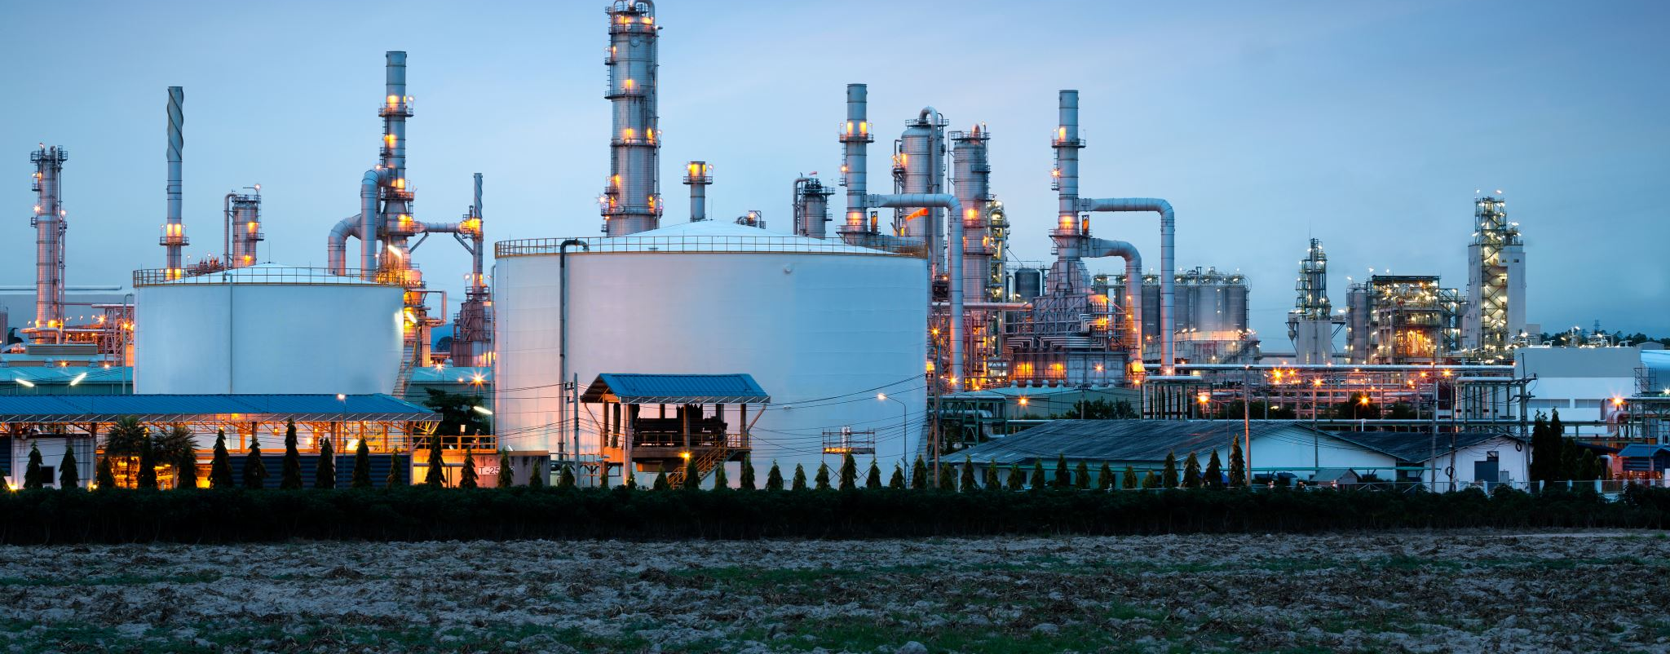
The Crude Oil Effect on Energy Stock

Slide 2
Introduction
Crude Oil
Raw materials to make different product
Energy Companies
- Upstream
- Refinery
- Petrochemical
What effect of crude oil on energy companies? Any relationship?

Slide 3
Methodology
Data Wrangling
- Data source
- Data cleaning
Data Processing
- Feature comparison of crude oil closing price vs. energy companies stock closing price
- SARIMAX model to predict the future price of crude oil and stock

Slide 4
Data Wrangling – Data Source
Crude oil
yahoo finance
Stocks
alphavantage (https://www.alphavantage.co) – 24 months stock
Energy Companies
ExxonMobil (XOM) , British Petroleum (BP), Royal Dutch Shell (RDS-B), Chevron(CVX), Valero (VLO), Marathon Petroleum Corp. (MPC), LyondellBasell (LYB), Slumberger (SLB), Halliburton (HAL), Total (TOT)

Slide 5
Data Wrangling – Data Extraction
Input Data
- Create a stock symbol list
- Pandas.read_csv
- Stock data
path+stock symbol + API key + time period
- Crude oil data
download data from yahoo finance
Output Data as individual file

Slide 6
Data Wrangling – Data Cleaning
Input Data
Open saved data files from data extraction
Drop Unnecessary Column
- Dropped open, high, low
- Keep closing price and volume
Average Data
Daily
Output Data

Slide 7
Data Exploration – Feature Comparison
Input Data
Feature Comparison
- Heat map
- Individual company comparison vs. crude oil closing price

Slide 8
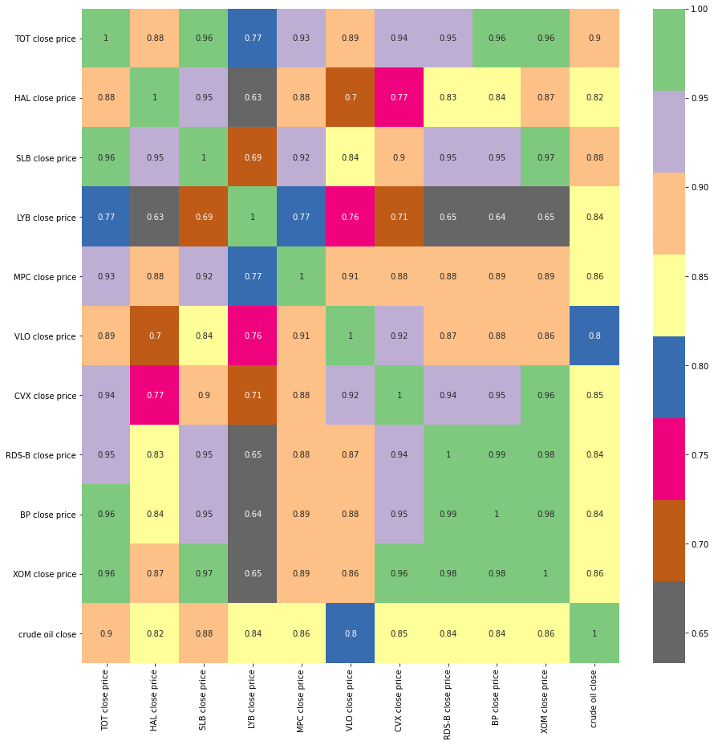
Feature Comparison - Heat Map
Crude oil affect stocks

Slide 9
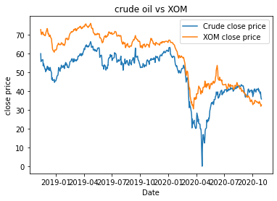
Feature Comparison – Crude Oil vs. XOM
-Before Apr. 2020, the XOM closing price trend well with crude oil closing price
- After Apr. 2020, the XOM closing price did not trend well with crude oil closing price
- Other factors affect the stock price

Slide 10
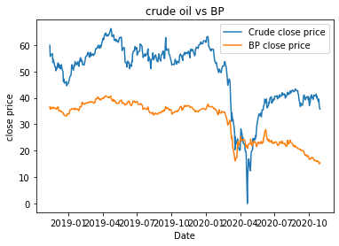
Feature Comparison – Crude Oil vs. BP
-Before Apr. 2020, the BP closing price trend well with crude oil closing price
- After Apr. 2020, the BP closing price did not trend well with crude oil closing price
- Other factors affect the stock price

Slide 11
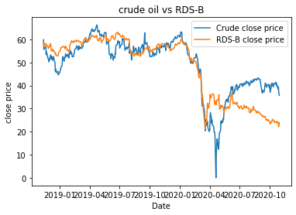
Feature Comparison – Crude Oil vs. RDS-B
-Before Apr. 2020, the RDS-B closing price trend well with crude oil closing price
- After Apr. 2020, the RDS-B closing price did not trend well with crude oil closing price
- Other factors affect the stock price

Slide 12
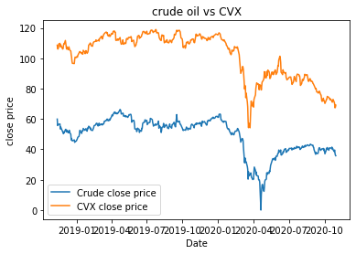
Feature Comparison – Crude Oil vs. CVX
-Before Apr. 2020, the CVX closing price trend well with crude oil closing price
- After Apr. 2020, the CVX closing price did not trend well with crude oil closing price
- Other factors affect the stock price

Slide 13
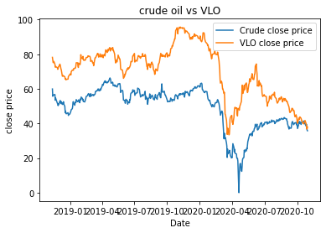
Feature Comparison – Crude Oil vs. VLO
-Before Apr. 2020, the VLO closing price trend well with crude oil closing price
- After Apr. 2020, the VLO closing price did not trend well with crude oil closing price
- Other factors affect the stock price

Slide 14
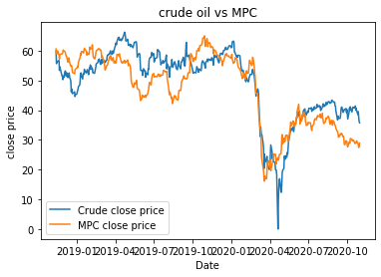
Feature Comparison – Crude Oil vs. MPC
-Before Apr. 2020, the MPC closing price trend well with crude oil closing price
- After Apr. 2020, the MPC closing price did not trend well with crude oil closing price
- Other factors affect the stock price

Slide 15
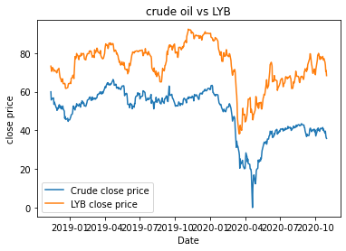
Feature Comparison – Crude Oil vs. LYB
- The LYB closing price trend well with crude oil closing price

Slide 16
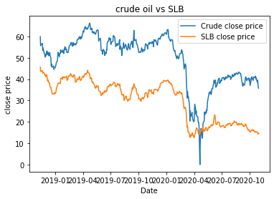
Feature Comparison – Crude Oil vs. SLB
- The SLB closing price trend well with crude oil closing price

Slide 17
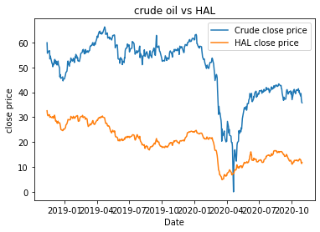
Feature Comparison – Crude Oil vs. HAL
- The HAL closing price trend well with crude oil closing price

Slide 18
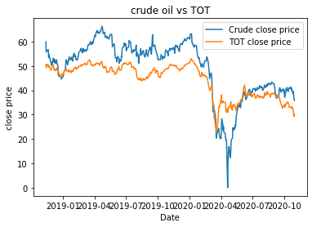
Feature Comparison – Crude Oil vs. TOT
- The TOT closing price trend well with crude oil closing price

Slide 19
Feature Comparison - Conclusion
Upstream / Refinery companies did not trend well with crude oil price after Apr. 2020
Petrochemical companies trend well with crude oil price
Oil field service companies trend well with crude oil price
Crude oil closing price significantly affect petrochemical and oil field services. However the trend did not fit well for the upstream / refinery companies

Slide 20
Data Exploration - Forecast
Input the data
Decomposed seasonal data
- 5 days
Dickey-Fuller test
Preprocess data
- difference of adjunct data
Optimization p,d,q
SARIMAX model fit
Model forecast

Slide 21
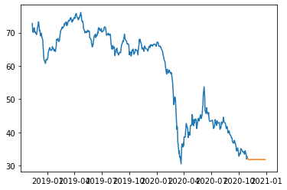
XOM Closing Price Forecast
Price would be around $31

Slide 22
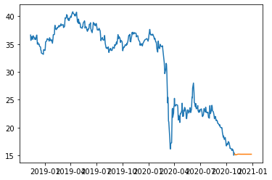
BP Closing Price Forecast
Price would be around $16

Slide 23
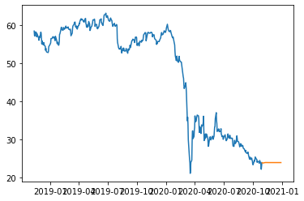
RDS-B Closing Price Forecast
Price would be around $23

Slide 24
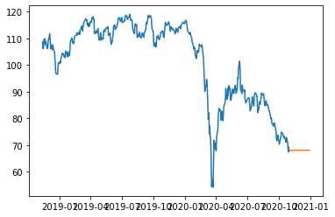
CVX Closing Price Forecast
Price would be around $65

Slide 25
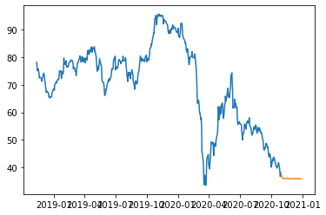
VLO Closing Price Forecast
Price would be around $36

Slide 26
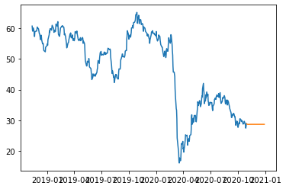
MPC Closing Price Forecast
Price would be around $28

Slide 27
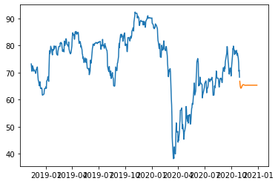
LYB Closing Price Forecast
Price would be around $62

Slide 28
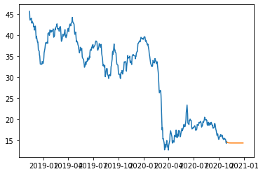
SLB Closing Price Forecast
Price would be around $15

Slide 29
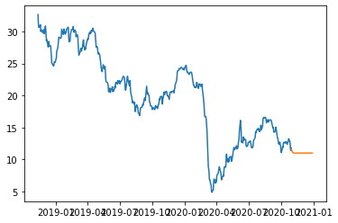
HAL Closing Price Forecast
Price would be around $12

Slide 30
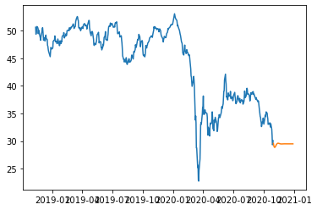
TOT Closing Price Forecast
Price would be around $27

Slide 31
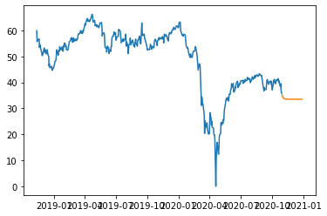
Crude Oil Closing Price Forecast
Price would be around $32

Slide 32
Forecast - Conclusion
All the stocks and crude oil closing price were unlikely to decrease in the next 60 days

